Slide 1

Speeding up design & development using template
First Prototype Fridays
The first prototype presents

Slide 2
Website templates

Slide 3
Theme forest
https://themeforest.net/
Grial Kit
https://grialkit.com/

Slide 4
Open source website resources

Slide 5

Free Vector drawings
undraw.co
Open-source illustration for any ideas

Slide 6

Freely Usable Images
www.unsplash.com
Open-source photos

Slide 7
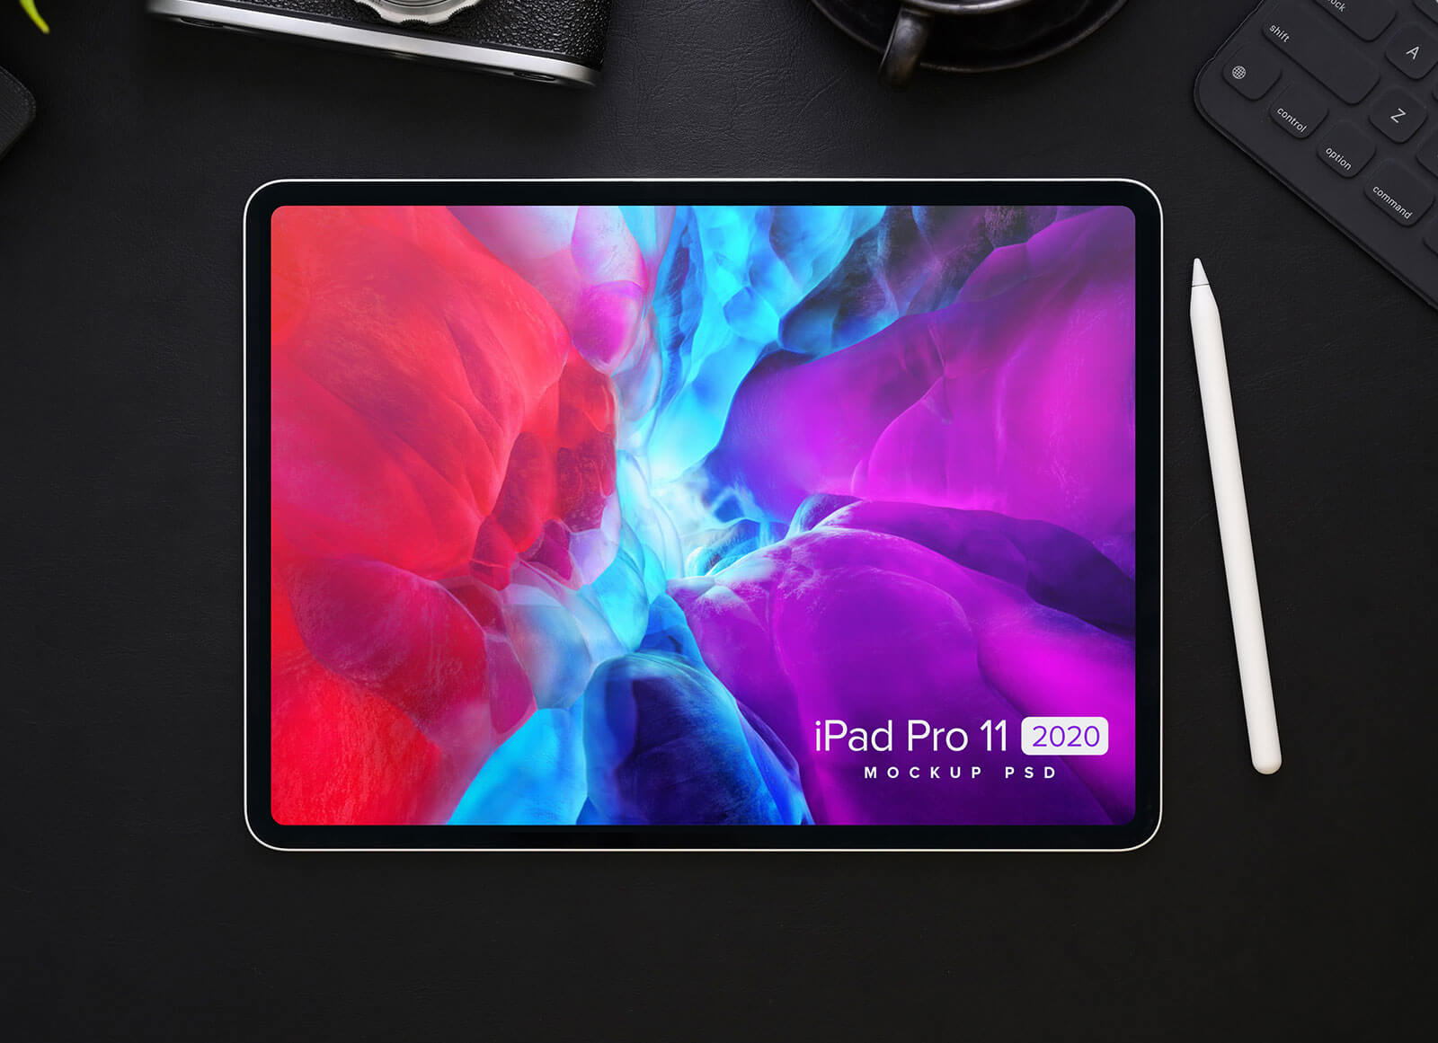
Free Mockup PSD
www.goodmockups.com
Free mockup templates for varies products

Slide 8

Free font website
www.dafont.com
Free font library

Slide 9

Free pattern website
http://tabbied.com/
Free website for patterns

